Slide 1
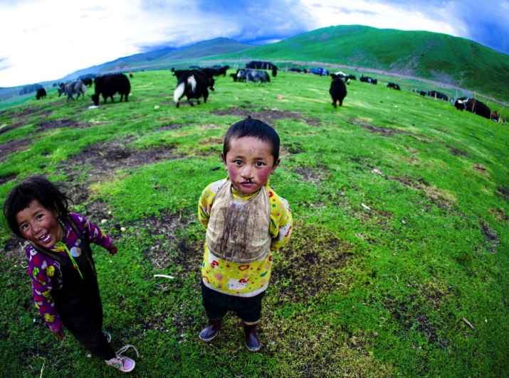
Smile Session 4
Bullying
Smile Train China

Slide 2
Disclaimer
The information provided in this webinar is meant to be helpful to you and is for informational purposes only. The information contained here should not be relied upon for any specific purpose or used as a substitute for medical advice. While we attempt to thoroughly address specific topics, it is not possible to address every unique situation. Please consult a professional with any questions you might have. Although we attempt to provide accurate and up-to-date information, we make no guarantee to that effect and are not responsible for the content of these resources. All liability with respect to actions taken or not taken based on the contents of the webinar are hereby disclaimed. The content is provided “as is” and no representations are made that the content is error-free.

Slide 3
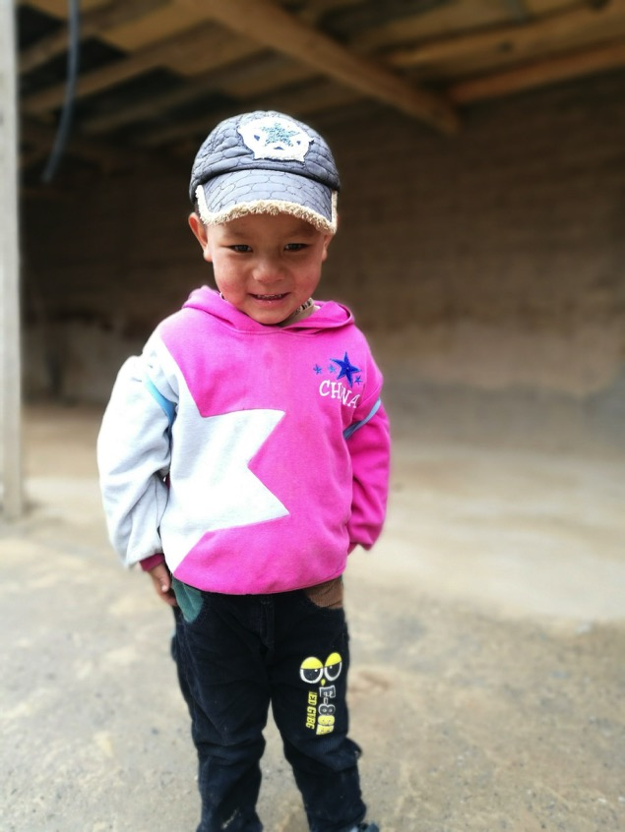
Objectives
Help children define and identify bullying
Teach students about how to prevent and stop bullying
Share how Smile Train helps in supporting children with clefts that may have experienced bullying

Slide 4
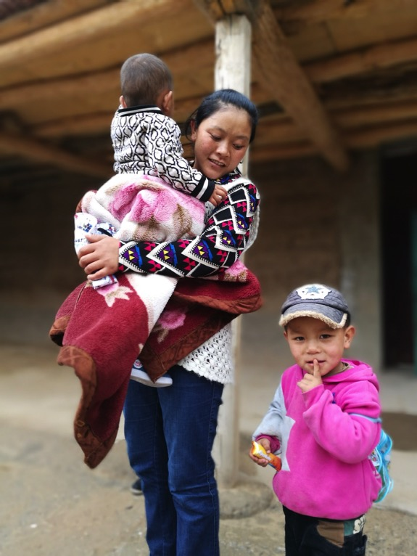
Lesson Information
Background
Making Connections
Activity
Notes:
This lesson is split into three sections; background, making connections, and a fun activity!

Slide 5
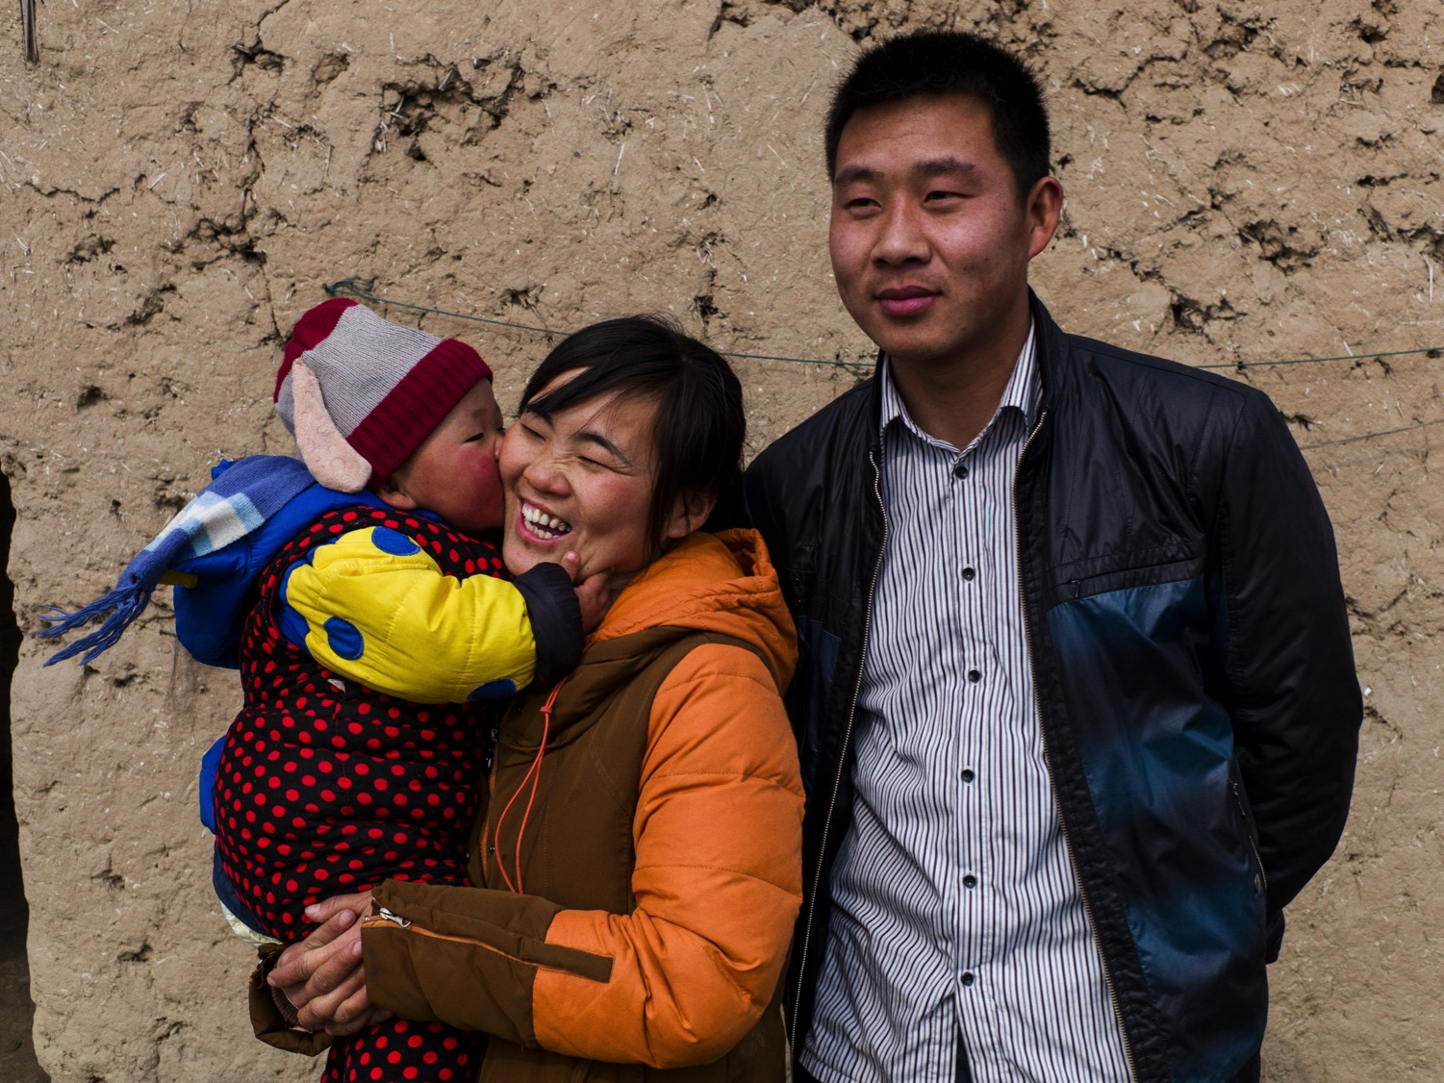
Background

Slide 6

What is Bullying?
Notes:
Bullying is aggressive behavior that either causes harm or discomfort to others. Generally there is a real or perceived power imbalance and the behavior is repetitive. Bullying can be direct (to the target) or indirect (such as spreading rumors).
Bullying is never okay and we are all responsible for standing up to it when we see it.

Slide 7

There are three categories of bullying
Physical
Verbal
Social
Notes:
There are three categories of bullying. They are physical, verbal, and social.
Physical bullying is when the bully harms their target’s body or possessions. Examples include hitting, tripping, or pinching the target, or breaking or stealing their things.
Verbal bullying is when the bully says or writes harmful things to or about their target. Examples include teasing, name-calling, or threatening physical or emotional harm.
Social bullying is when the bully seeks to harm the target’s relationships or reputation. Examples include spreading rumors, embarrassing someone, or leaving someone out of activities.

Slide 8
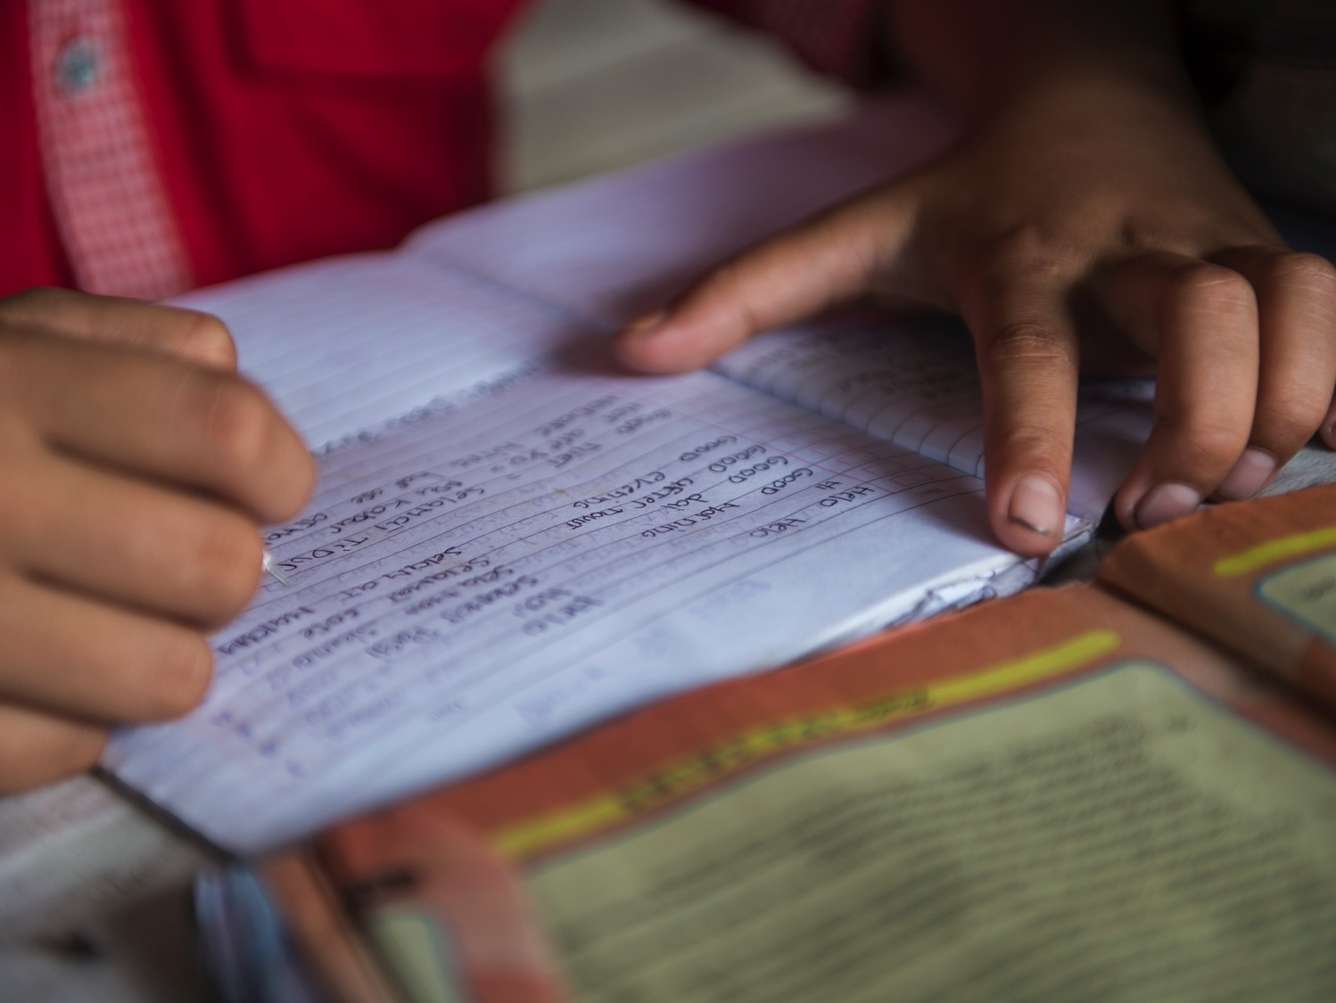
What are the effects of bullying?
Depression and anxiety
Health complaints
Trouble at school
Notes:
Kids who are bullied can experience negative effects related to their mental and physical health and their performance at school.
Depression and anxiety, increased feelings of sadness and loneliness, changes in sleep and eating patterns, and loss of interest in activities they used to enjoy.
Health complaints. Children and adolescents who are bullied have a higher risk for psychosomatic problems such as headache, stomach ache, backache, sleeping difficulties, tiredness and dizziness.
Decreased academic achievement—GPA and standardized test scores—and school participation. They are more likely to miss, skip, or drop out of school.

Slide 9

How do we prevent and stop bullying?
Buddy System
Stay positive
Walk away
Find an adult
Be confident
Communicate

Slide 10
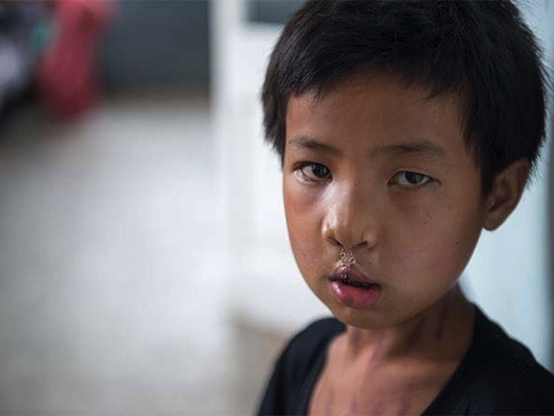
Smile Train supports kids who have been bullied
Educational resources
Connecting the cleft community
Psychosocial support programs
Notes:
Children born with clefts may have visible scars and/or differences in speech that can lead them to feeling different and/or being treated differently by peers. This can lead to poor self-esteem and self-image issues which may prevent children from reaching their full potential.
Smile Train is working hard to develop comprehensive education resources to help children with clefts and their families understand the care they need and feel supported as they progress through their infancy, childhood, adolescence and even adulthood.
Smile Train is connecting with cleft community members and groups around the world to help strengthen their work and footprint.
Smile Train has piloted a few psychosocial support grant programs in Mexico and the Philippines. These grants have primarily been focused on organizing camps for children that address their feelings on their cleft and also connects children to peers going through similar challenges and treatments
Smile Train builds confidence with smiles. Smile Train helps kids become more comfortable with themselves and boosts their self esteem.

Slide 11
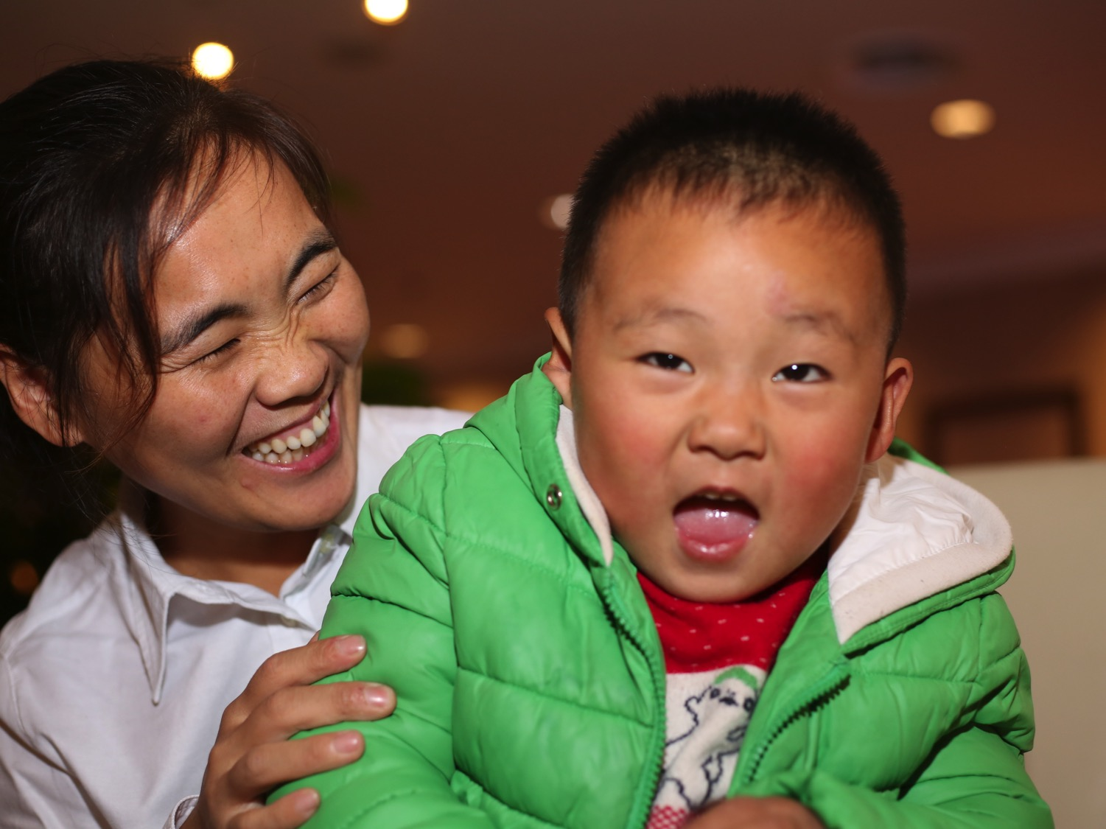
Making Connections

Slide 12
Smile Train China Background
Smile Train China was established in 1999
Smile Train has partnerships with 158 hospitals
372,000 Smile Train-supported cleft treatments provided​

Slide 13
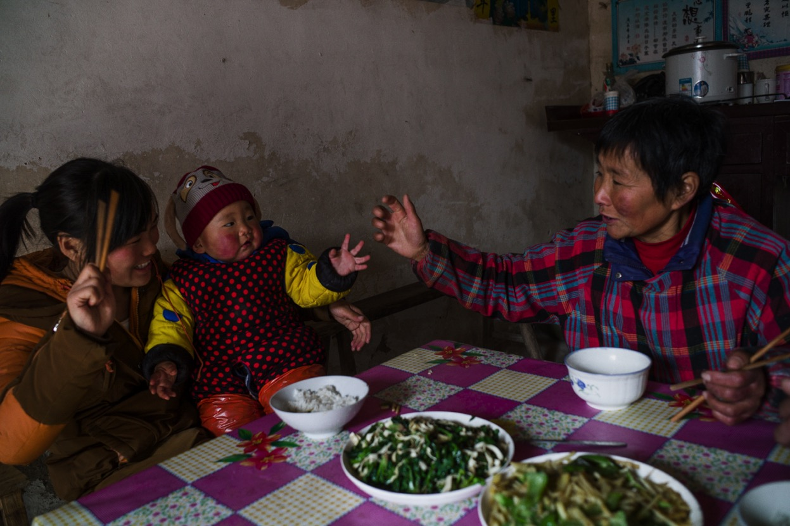
Wang Li Video
Notes:
https://www.youtube.com/watch?v=enXe5YyjZ64

Slide 14

Li Suhai Story
Notes:
https://www.smiletrain.org/stories/li-suhai-improbable-college-dream

Slide 15
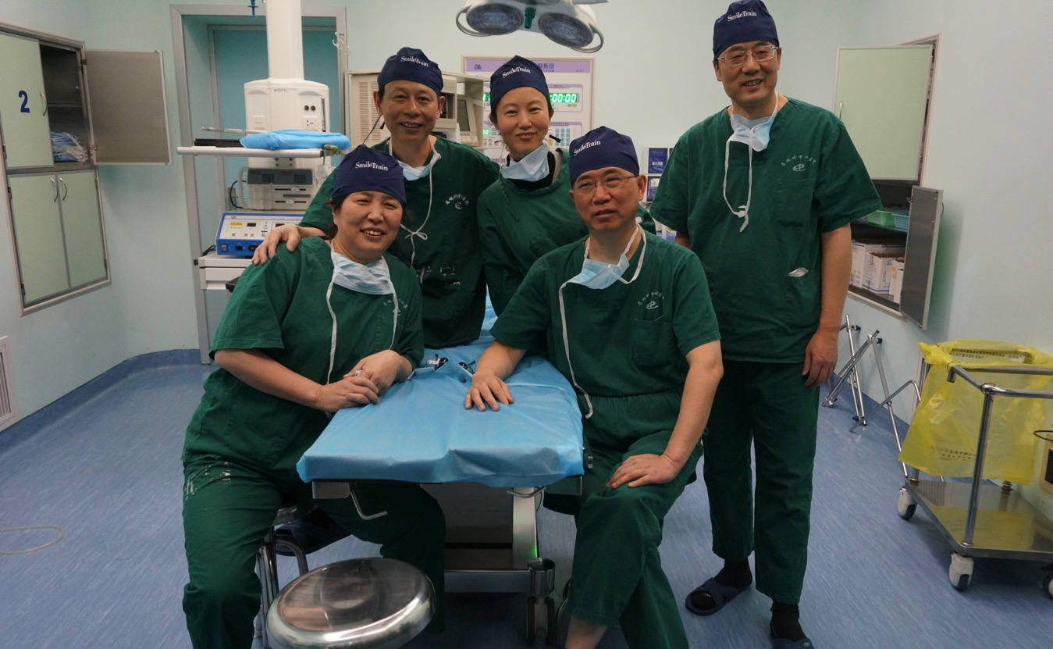
Li Suhai Story
Notes:
https://www.smiletrain.org/stories/li-suhai-improbable-college-dream

Slide 16
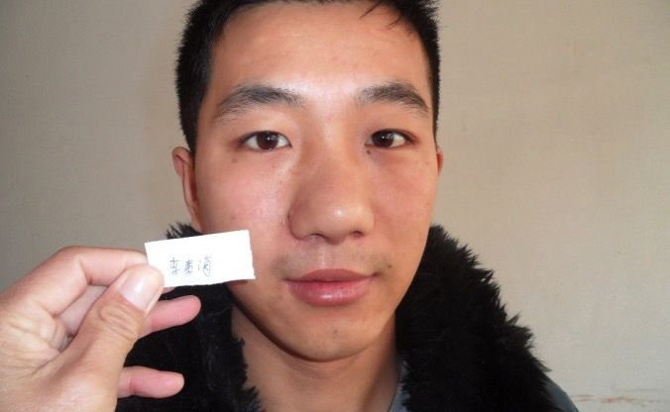
Li Suhai Story
Notes:
https://www.smiletrain.org/stories/li-suhai-improbable-college-dream

Slide 17
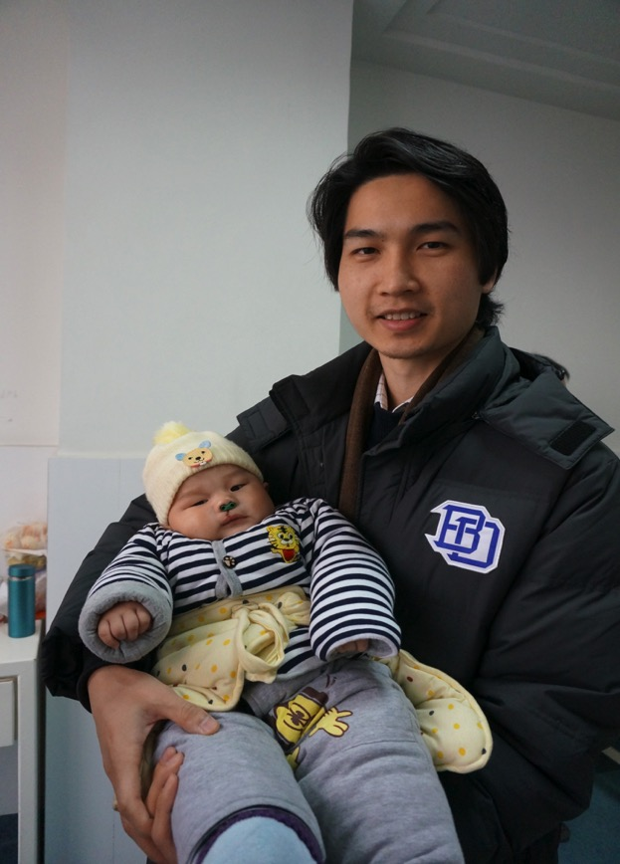
Questions for Connection
What is bullying?
What are some effects of bullying?
How can we prevent and stop bullying?
Who can you talk to if you are bullied?
How does Smile Train support kids who are bullied?
Was Li Suhai bullied?

Slide 18
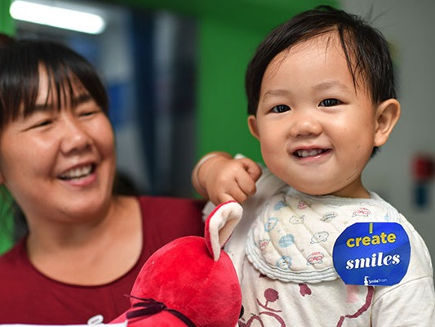
Anti-Bullying Activity

Slide 19
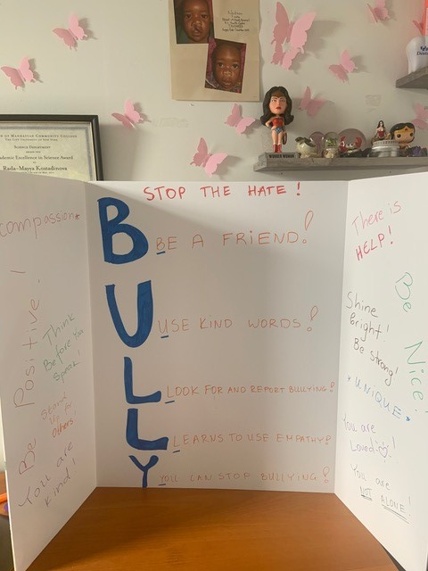
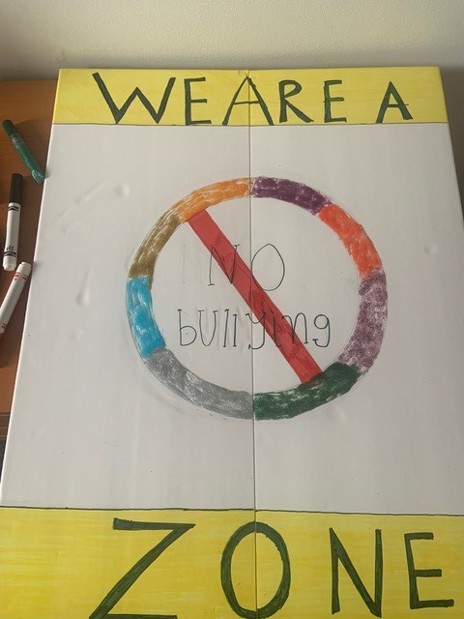
Activity Video
Notes:
https://youtu.be/uM3yvNlm2_A

Slide 20
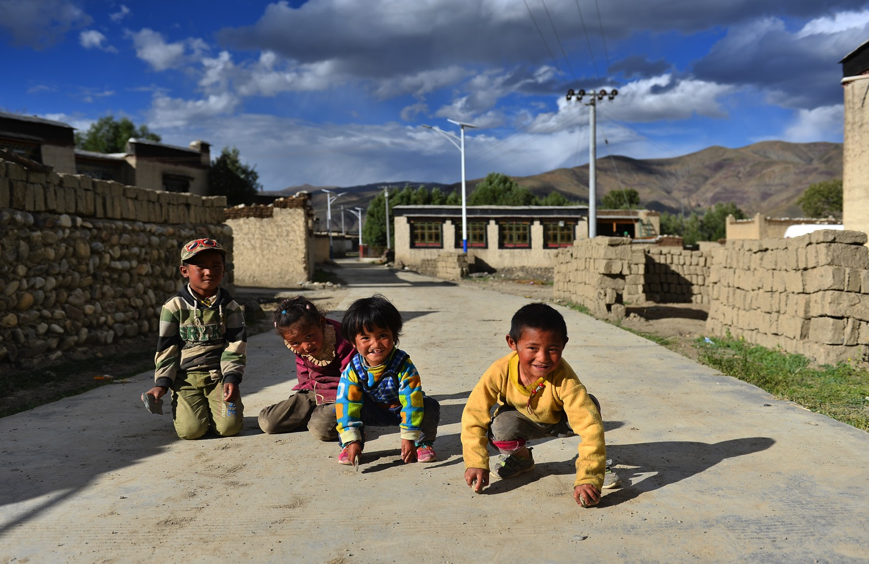
smiletrain.org
@Smiletrain
Thank You

Slide 21
Sources
Smile Train. Main Website. https://www.SmileTrain.org
Stop Bullying. Main Website. https://www.stopbullying.gov/
Wolke, Dieter and Suzet Tanya Lereya. “Long Term Effects of Bullying.” NCBI/NIH. (2015). https://www.ncbi.nlm.nih.gov/pmc/articles/PMC4552909/

